Slide 1

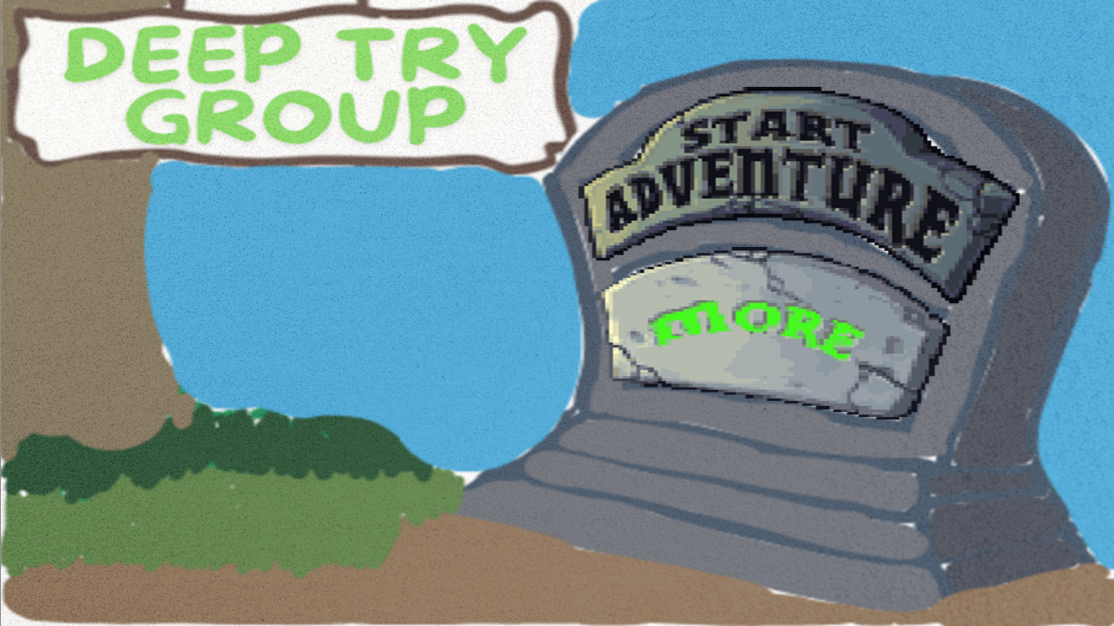


DEMO

Slide 2



15 June, 2024
PVZ-
DEEPTRY
DSA-Project
Advisor:
VTTín

Slide 3



Lý Khải Minh
ITITSB22008
TEAM MEMBERS
Do Minh Duy
ITITSB22029

Slide 4
1.
2.
Introduction
Gameplay
CONTENT
3.
4
Demo
Software requirement
5.
6.
UML/Class Diagram
Conclusion

Slide 5
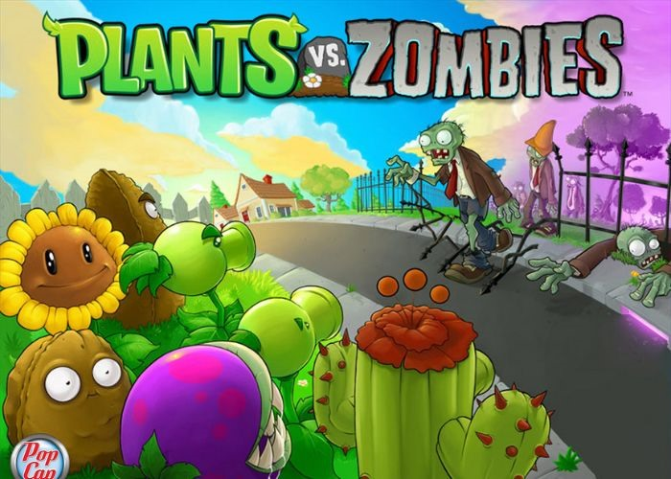

INTRODUCTION
In our game, we implemented a simplified version of the "Plants vs. Zombie" game by applying OOP principles such as encapsulation, inheritance, and polymorphism to ensure the code is modular and maintainable. Besides, we also create an engaging and interactive game experience.
We added some features in the game:
- Skip the starting levels for faster accessibility.
- Remove the lawn mowers (harder gameplay).
- Add new zombie: “Brickhead”.

Slide 6
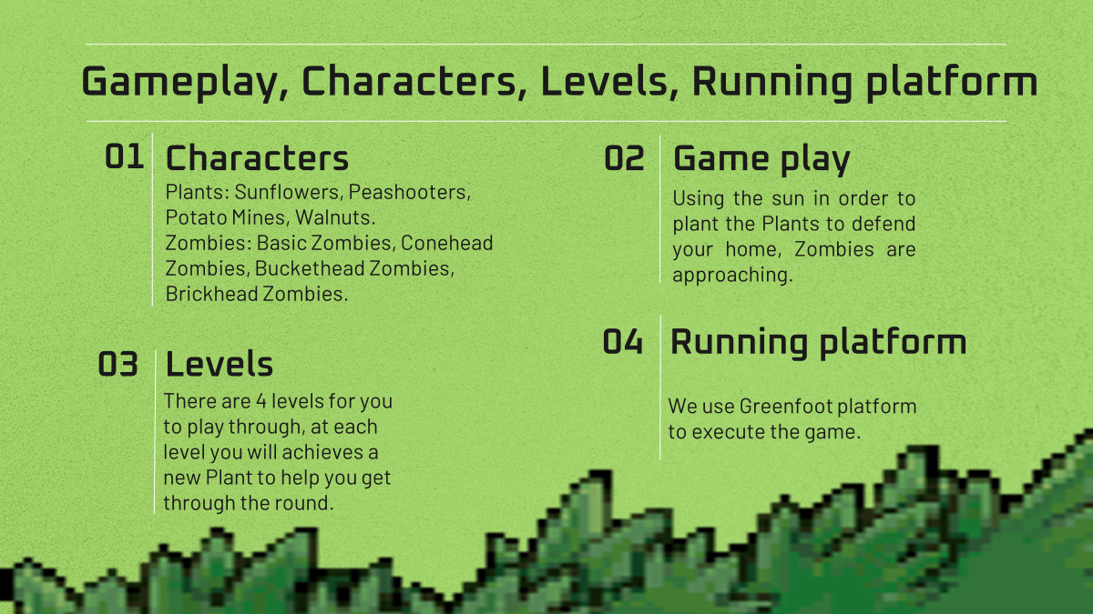

Slide 7




Software
Requirement
Canva/Photoshop
UML making
Creating background
Editing Image
GreenFoot and VSCode
Execute game
Creating game elements
Github
Commiting Work

Slide 8

UML/CLASS DIAGRAM

Slide 9
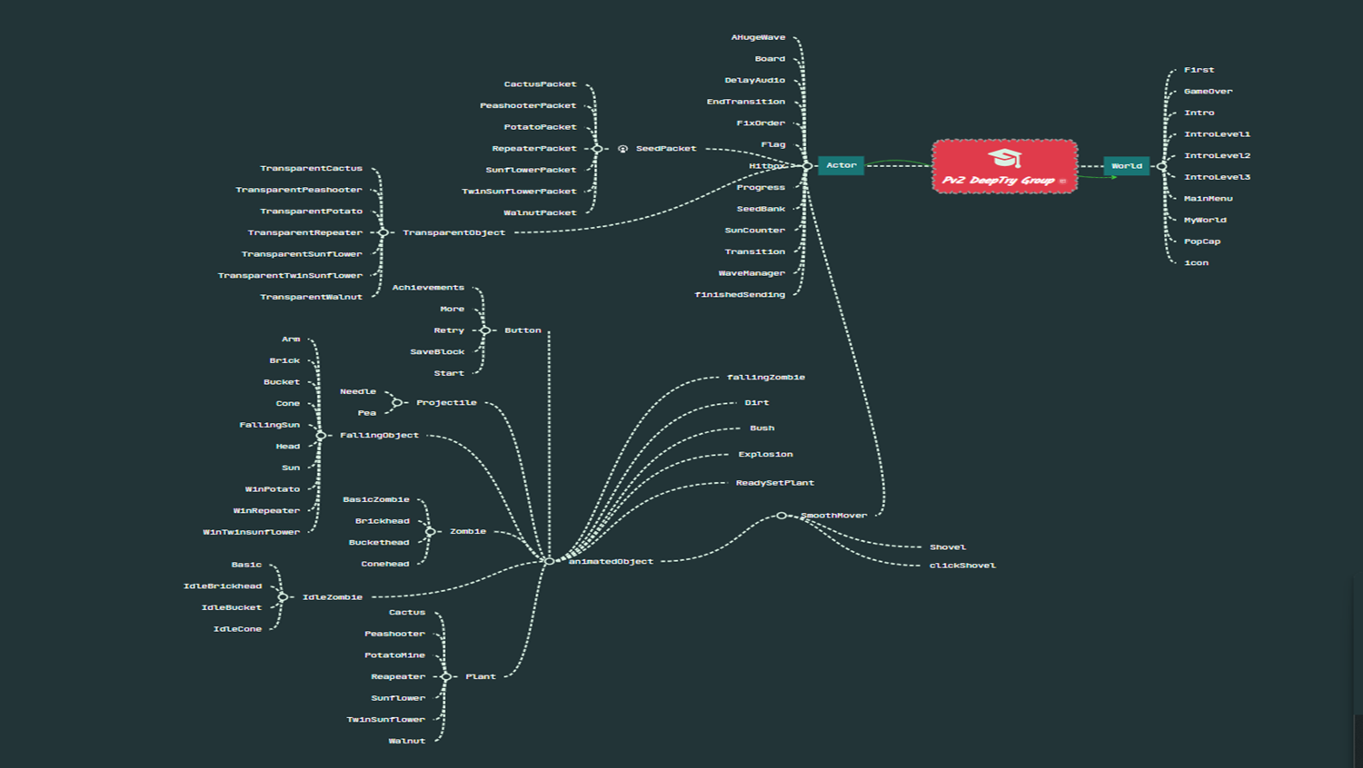

Slide 10
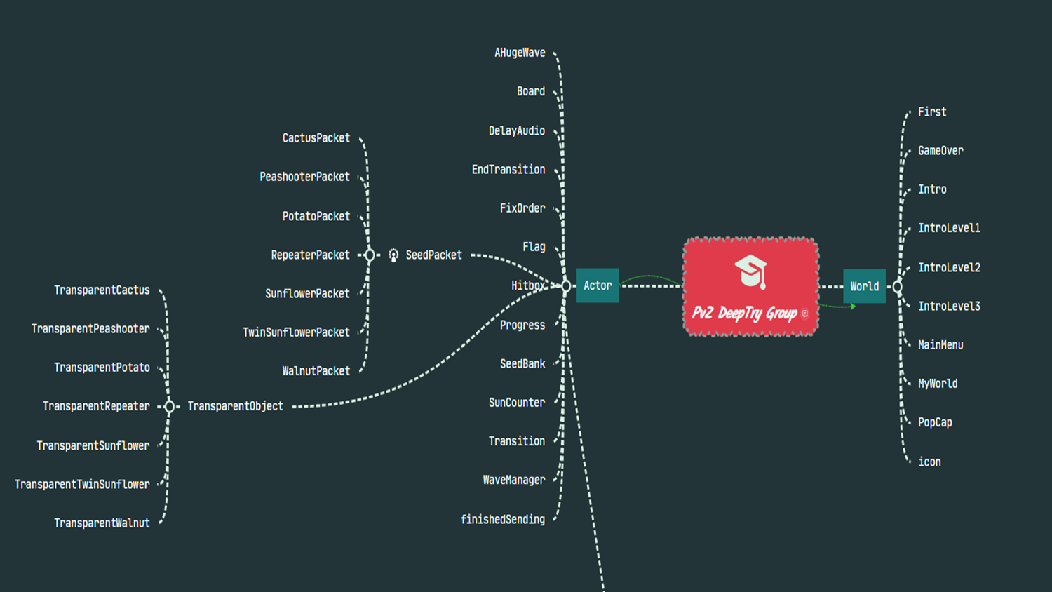

Slide 11
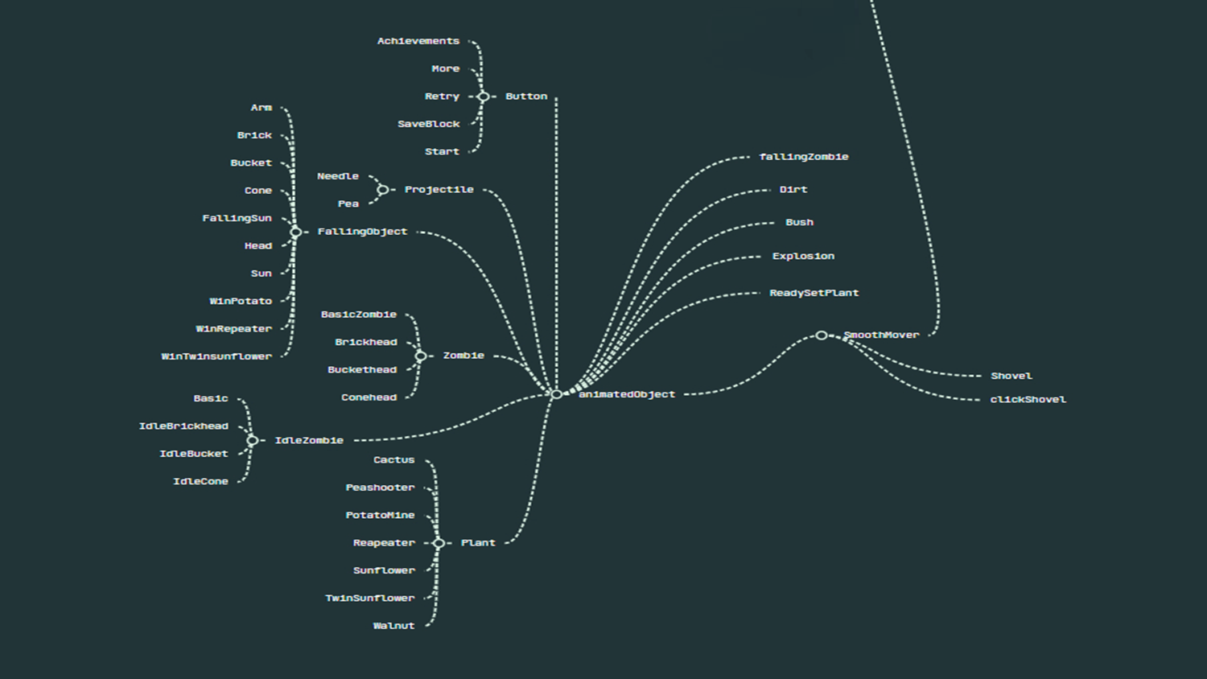

Slide 12
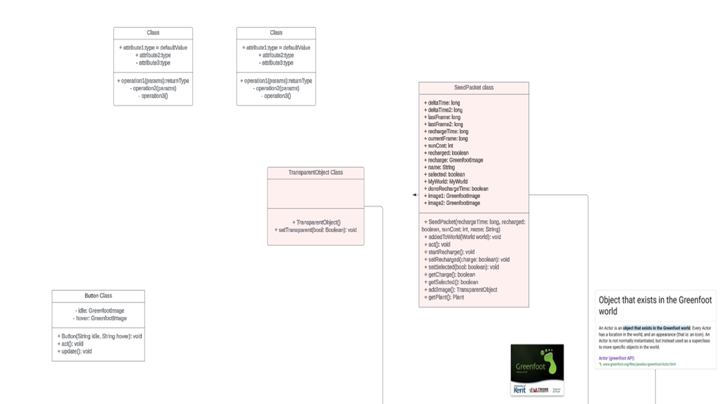

Slide 13
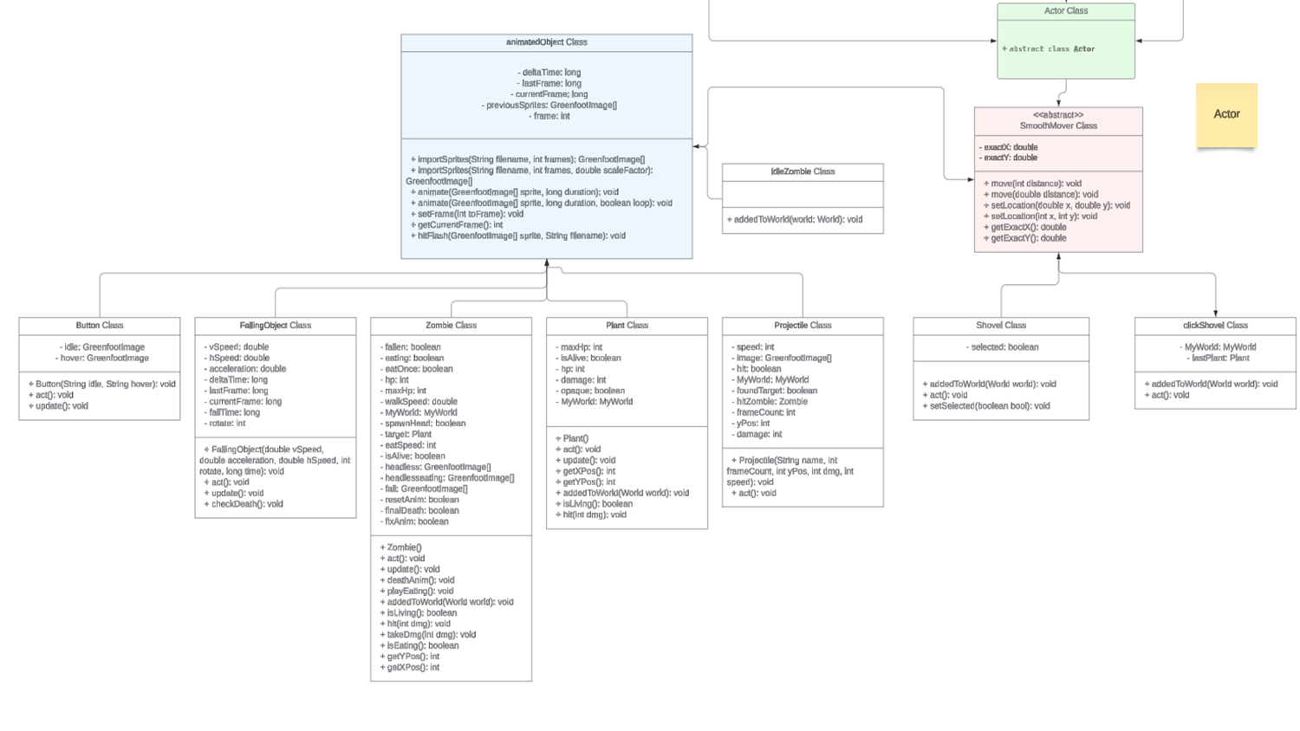

Slide 14
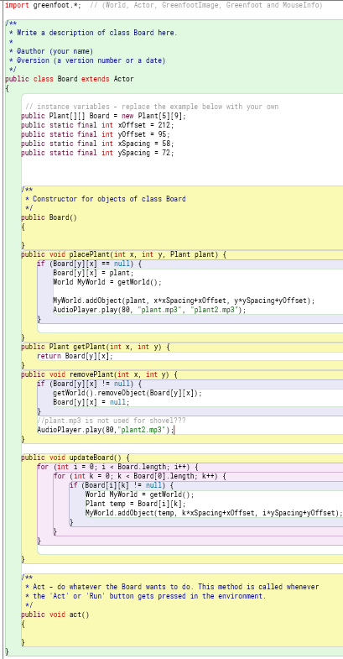
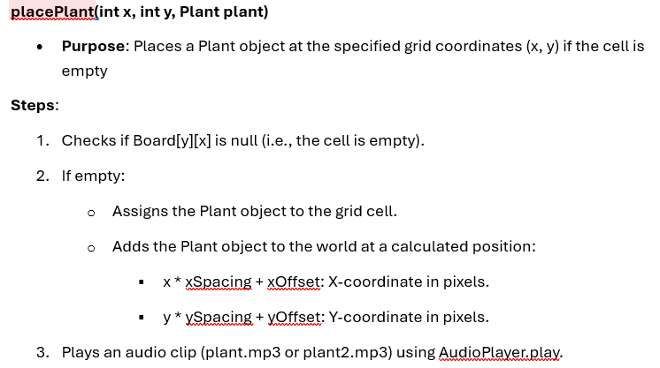
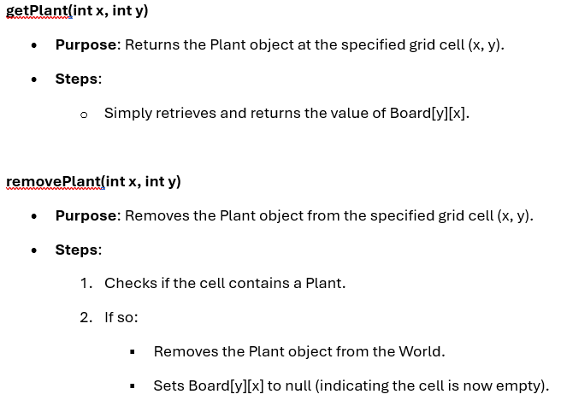
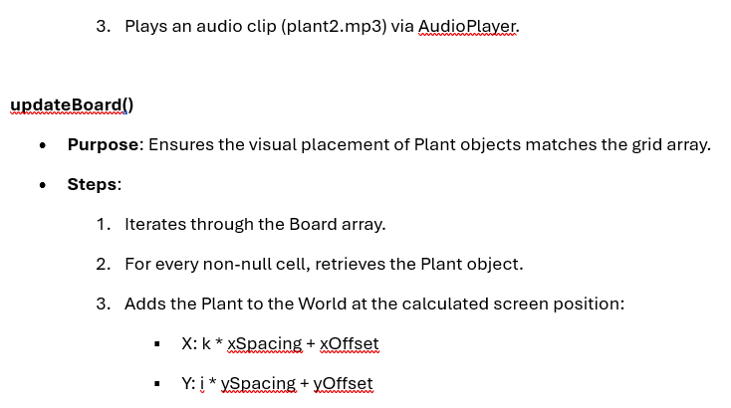
HOW IT WORK
HOW TO PLACE A PLANT?

Slide 15
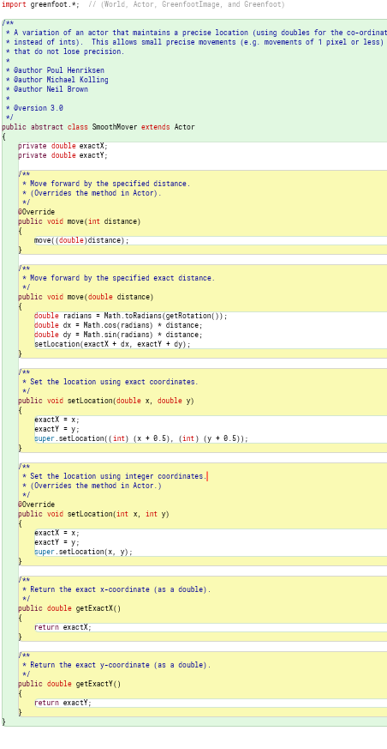
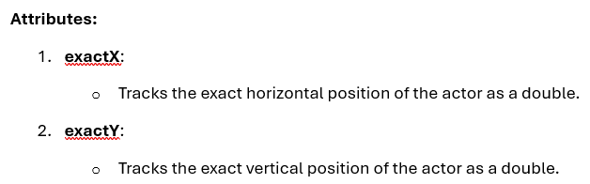
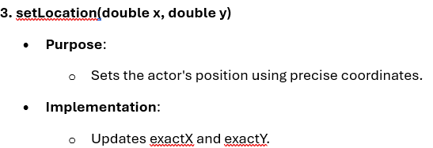
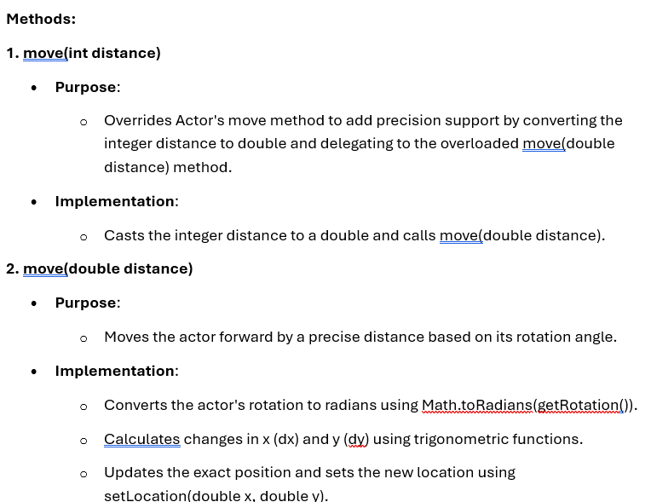
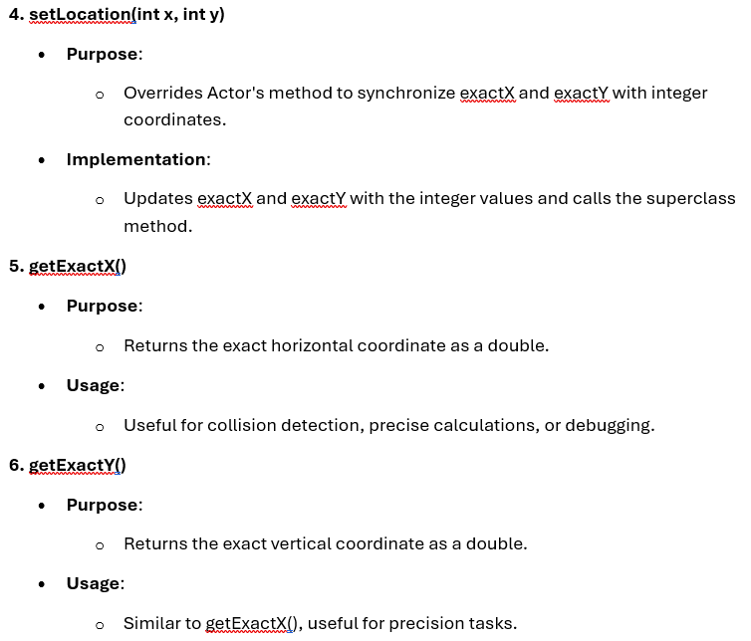
HOW IT WORK
MOVING MECHANISM

Slide 16
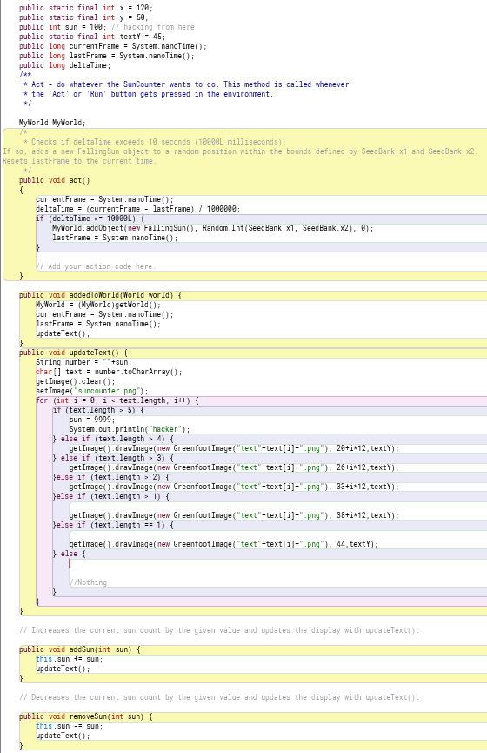
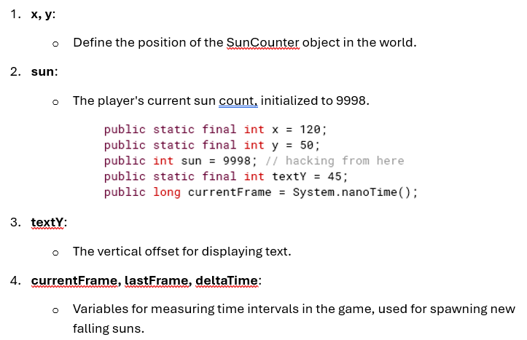
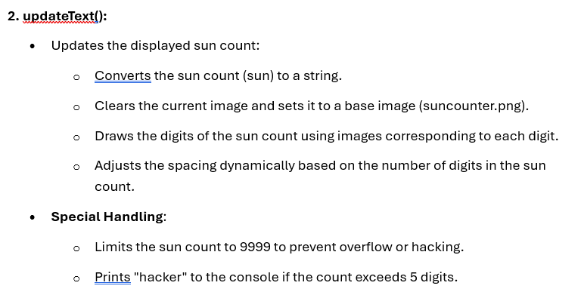
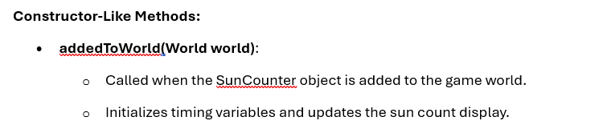
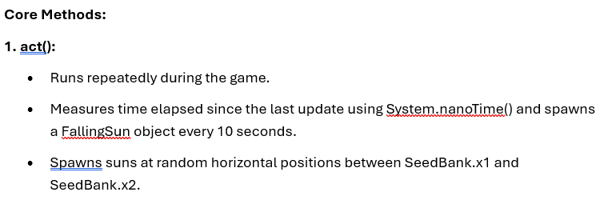
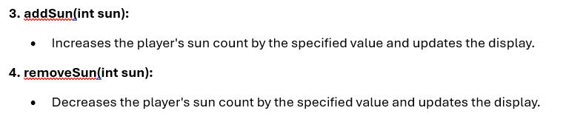
HOW IT WORK
SUN COUNTER MECHANISM

Slide 17
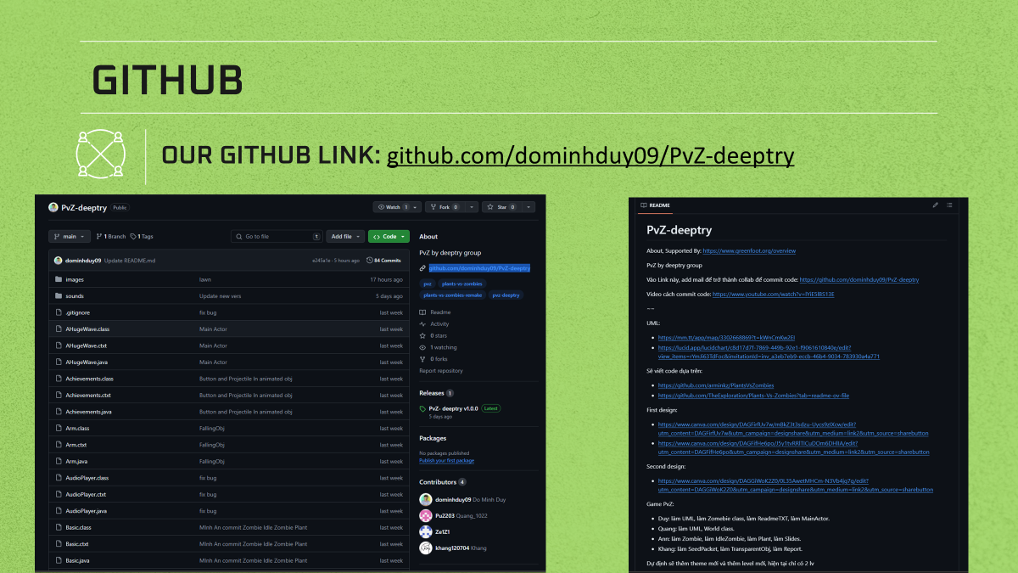

Slide 18
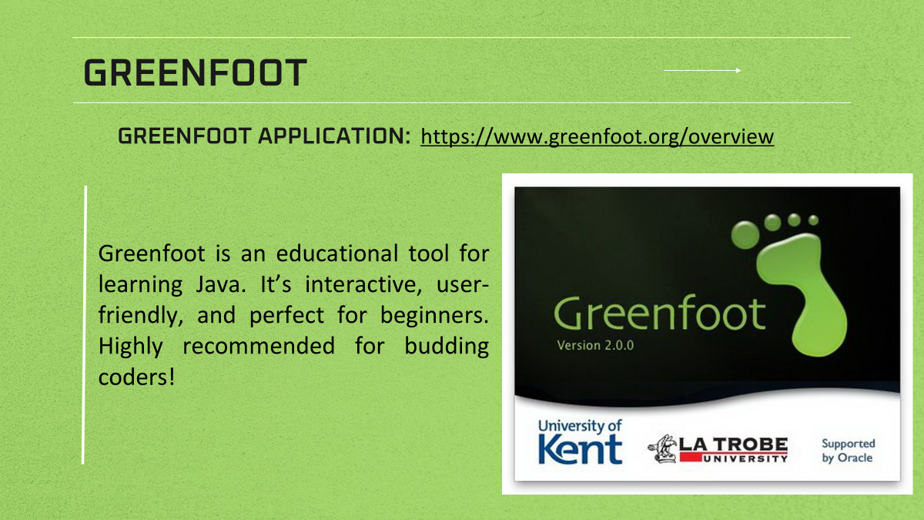

Slide 19

CONCLUSION

Slide 20
THANK YOU

